Slide 2
“Aibawk Cluster will be developed as a cluster with access to Social, Economic, Educational, Health and Digital amenities focusing particularly on Agriculture & allied, Rural infrastructure, and Eco-Tourism by utilizing the wealth offered by the vast virgin forest land while conserving it.”
VISION OF THE CLUSTER

Slide 3
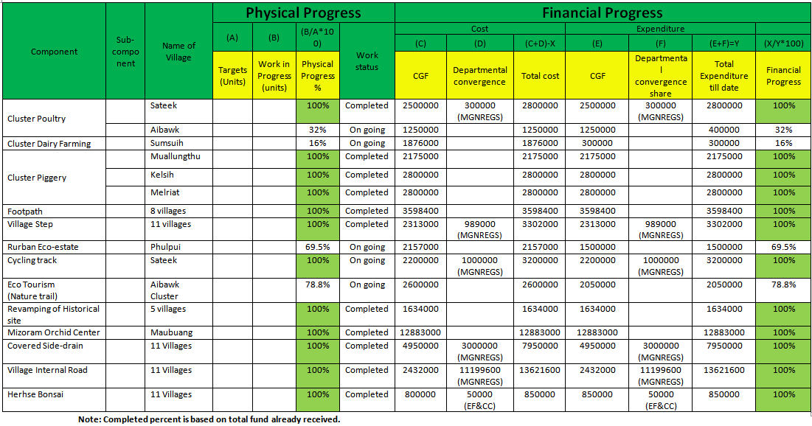
PHYSICAL & FINANCIAL PROGRESS REPORT OF WORKS UNDER SPMRM,
AIBAWK RURBAN CLUSTER
(Since Inception)

Slide 4
Outcomes Achieved
Assets created under Social Infrastructure like Pedestal Footpaths, Village Steps, Side drains etc.
Up gradation of water Pipelines in 11 Villages
Completion of big promising Projects like Mizoram Orchid Centre, Maubaung
Cluster Piggery and Poultry farming
Construction of Separate Toilet for Boys and Girls at Govt Schools
Assets created under Eco Tourism like Sateek Cycling Track, revamping of historical sites
Outcomes Envisaged( FY 2019-20)
Wholesale market at Sateek Village
Inter Village Road Connectivity
Agricultural Linked Road

Slide 5
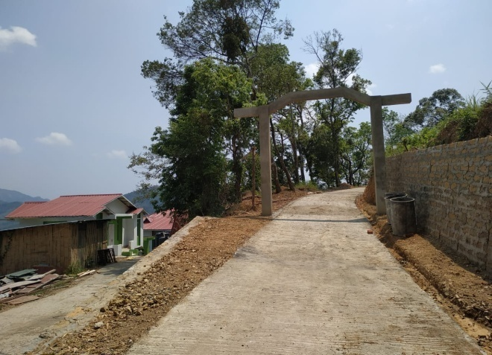
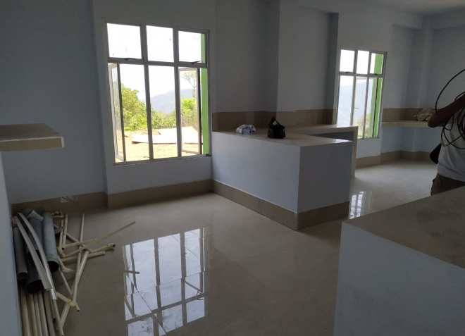
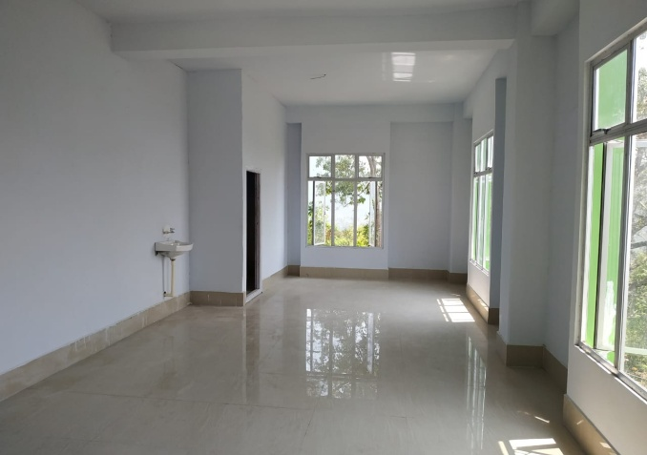
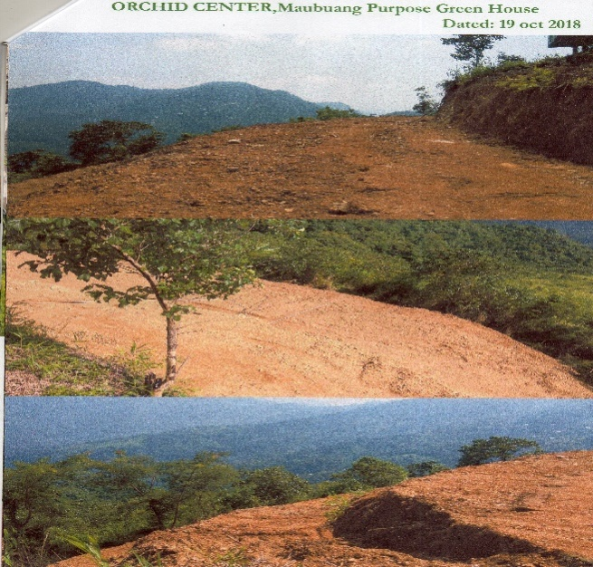
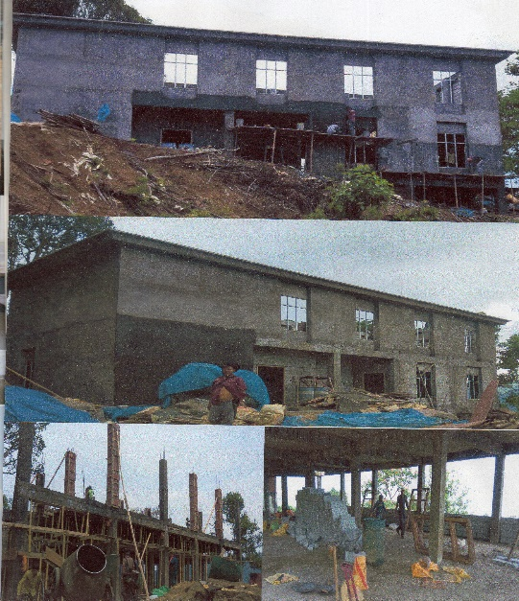
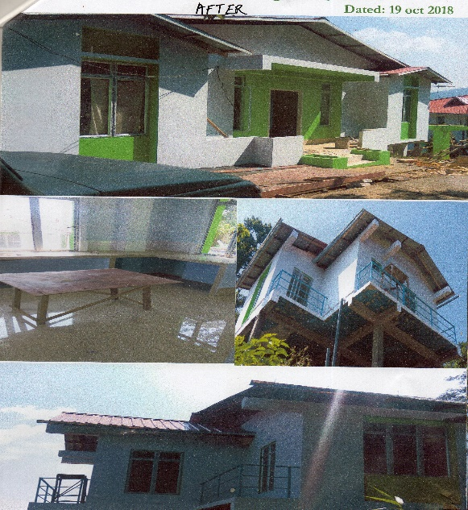
Mizoram Orchid Centre, Maubuang

Slide 6
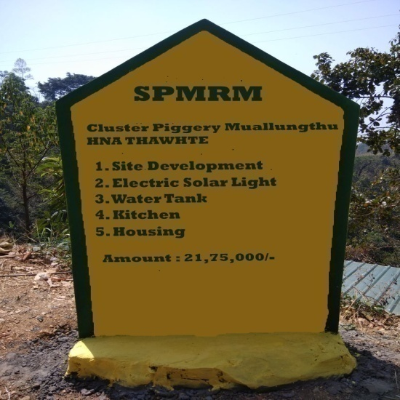
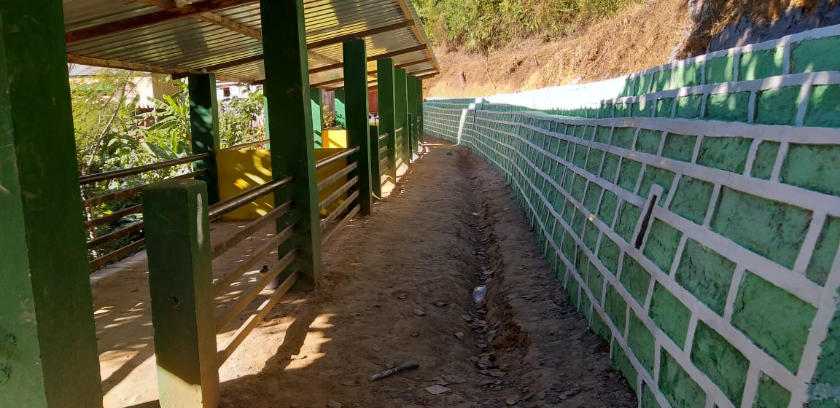
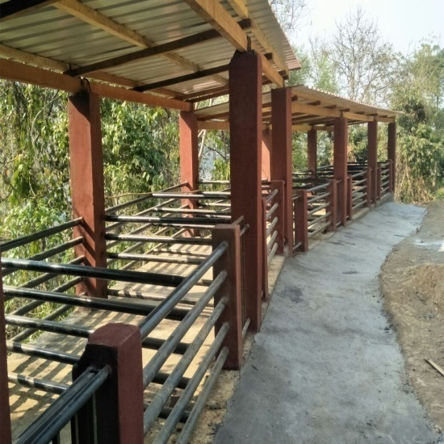
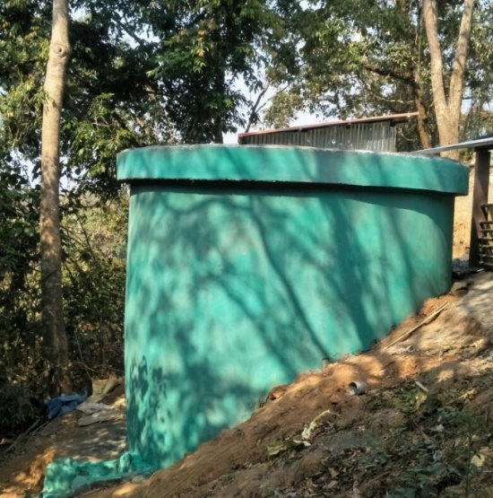
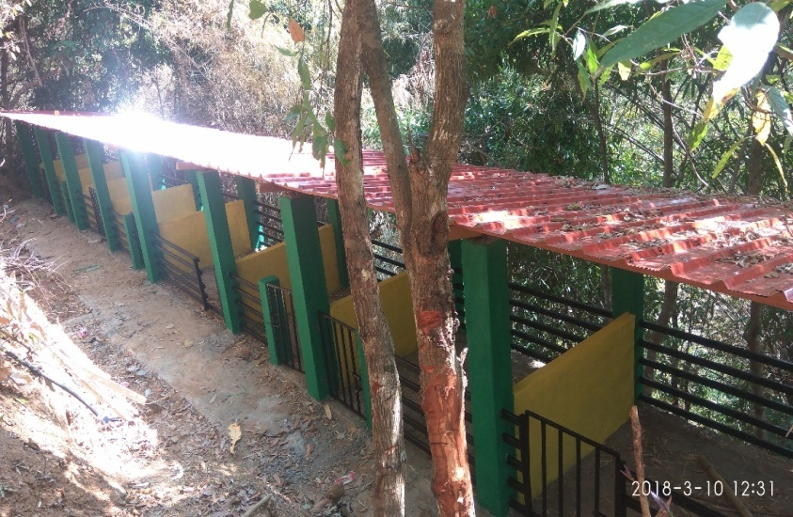
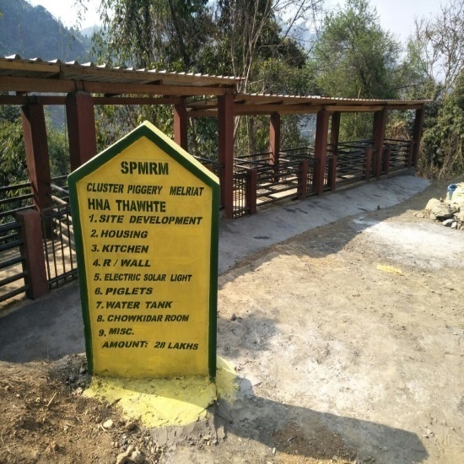
Cluster Piggery Farming at Muallungthu, Kelsih and Melriat

Slide 7
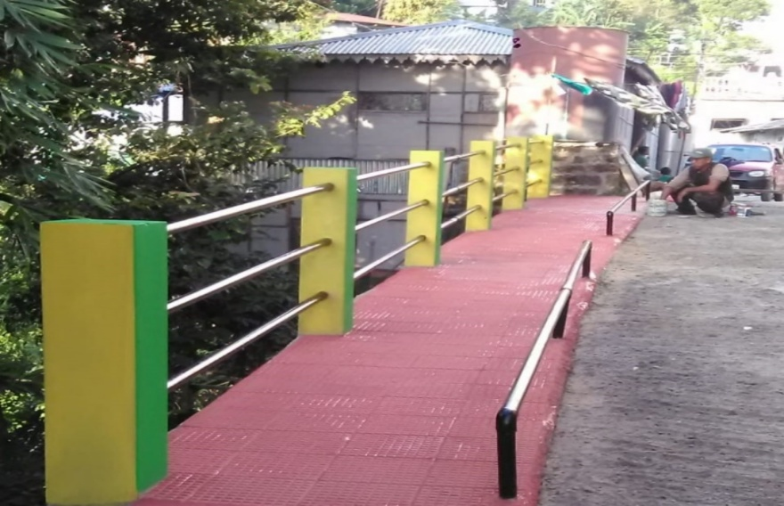
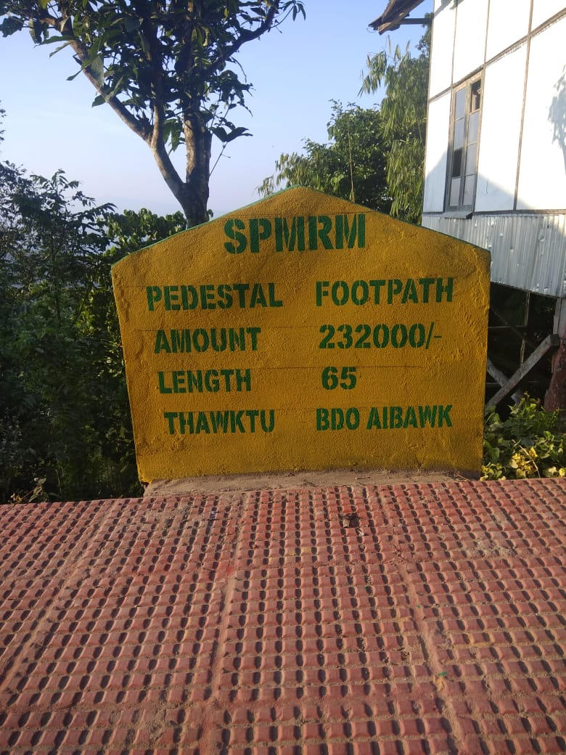
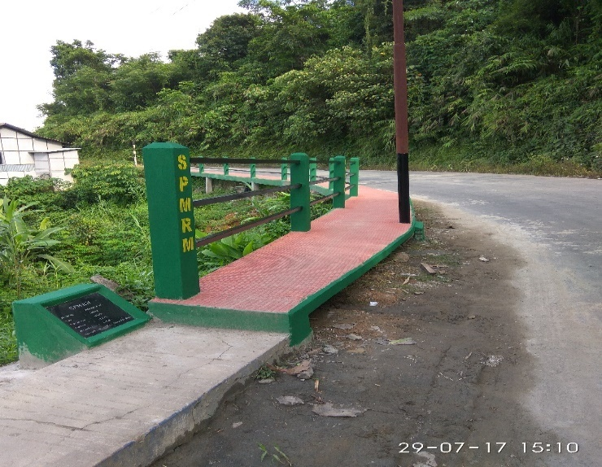
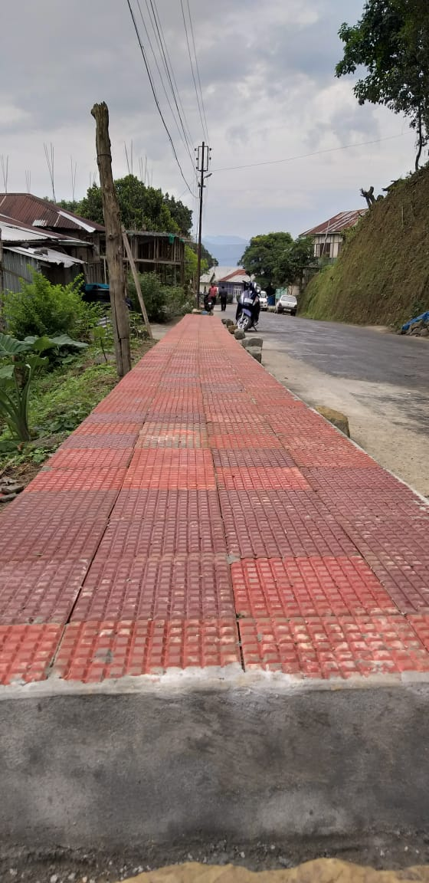
Pedestal Footpath

Slide 8
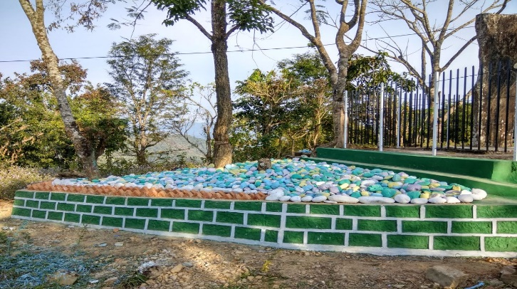
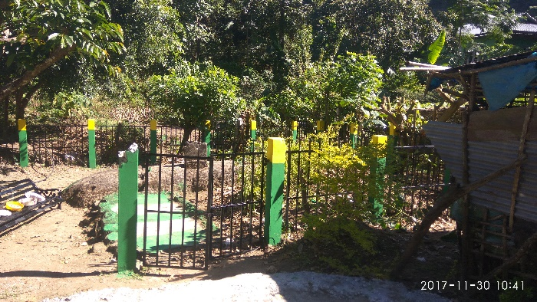
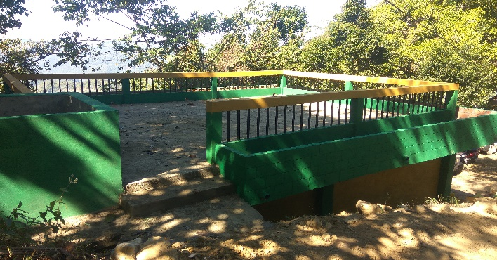
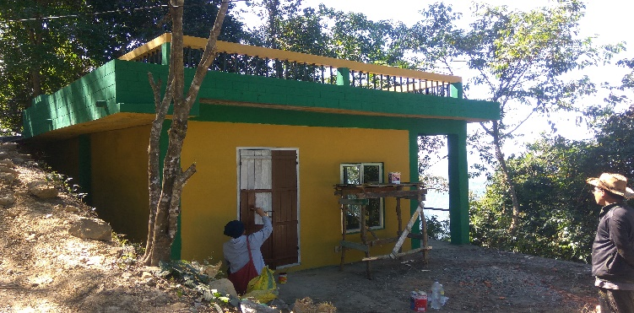
Eco-Tourism nature trail

Slide 9
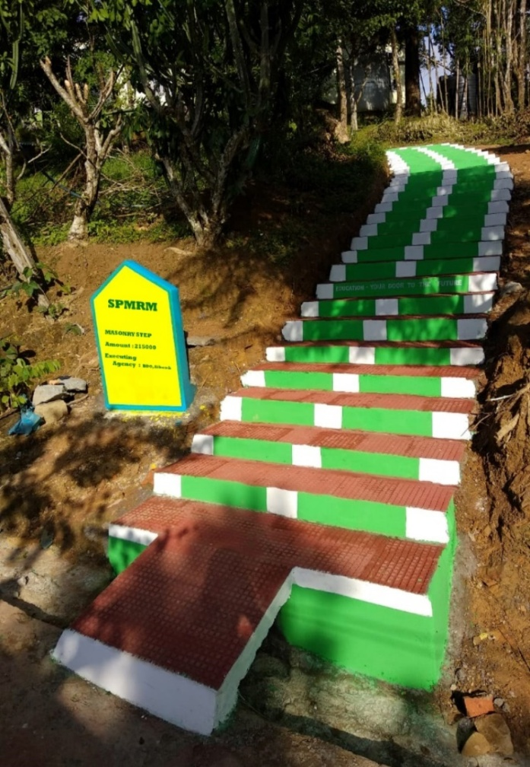
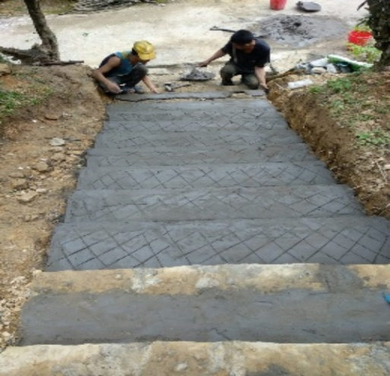
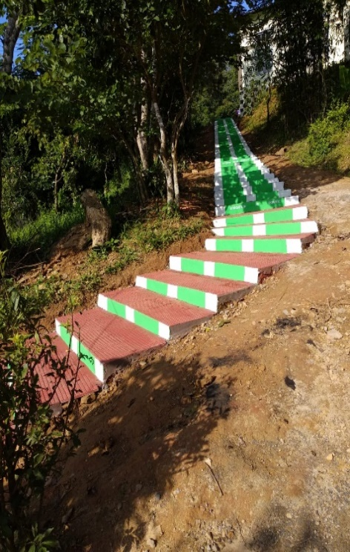
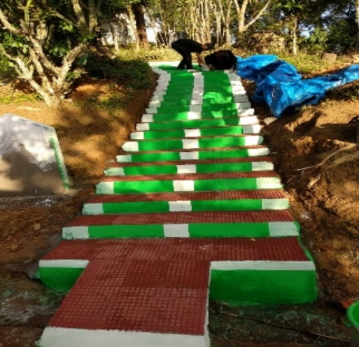
Village Steps

Slide 10
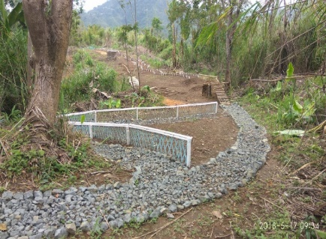
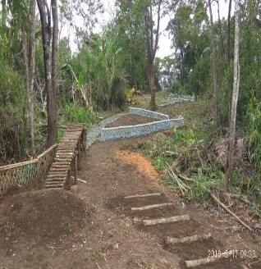
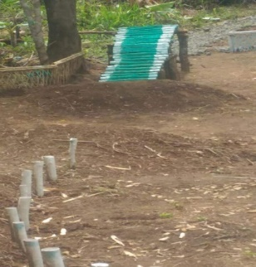
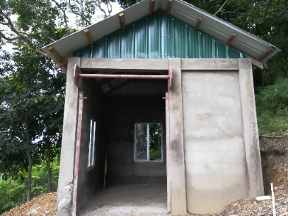
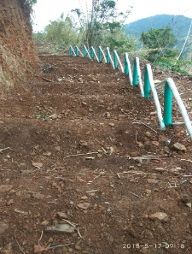
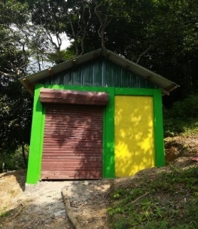
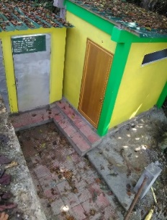
Cycling Track at Sateek

Slide 11
Special Initiatives Taken for timely execution of Projects Convergence Plan
Identification of State and Central Sector Schemes by SPMU/STSA
Obligatory timeline and year wise targets for project completion issued to all line departments by SNA
Pooling of funds from State and CSS in consultation with line departments
Obtaining approval from line departments during SLEC meeting
Implementation of works by the Block Office with well defined monthly targets

Slide 12
Operations and Maintenance Strategy
Developmental Works are Identified as per Village Council Resolutions
Assets created through Rurban Mission are handed over to Village Councils for Operation and Maintenance
Assets created should provide space for add on fitting in the future for expansion and enlargement projecting on population projection and trends.
User fees for all public and government based assets are levied by the Village Council
Micro-detail plan for O&M will be specific against concerned department but uniformity and integration of standard to be maintained.
Community participation in terms of voluntary manual labor or contribution in terms of any kind to be promoted.

Slide 13
Role of Elected Representatives in the Cluster
Since Mizoram falls under 6th Schedule, the village administration is governed by Mizo Customary Law through respective Village Councils
The Council is the Nodal body of various departments for developmental works of the village
All Village Council Executives are members of Block Level Coordination Committee constituted for Rurban Cluster which is headed by the BDO
The Council assist in promoting Livelihood activities for Poor farmers through various Programmes
Operation and Maintenance of assets created by Rurban Mission
Maintaining Rules and Regulation of the Village through Mizo Customary Law
Promotion of local level education especially Primary Education
To establish, assist and enhance Social Welfare activities

Slide 14
THANK YOU!

